Slide 1

APPLE STOCK PRICE PREDICTION
DS640 - Predictive Analytics and Decisions Modeling
Hoang Thu Thao Nguyen
Kishan Kanubhai Patel
Gaurav Bhalchandra Akrekar

Slide 2
AGENDA
Q1
Q2
Q3
Q4
Business Understanding
Data Understanding and Data Preparation
Machine Learning Model
Extend Use of Project
Collect dataset
Understanding data
Cleaning raw data
Multi Linear Regression Technique

Slide 3




PROBLEM STATEMENT
We are going to predict the Apple stock price (ticker: AAPL) based on previous prices from the data collection.

Slide 4
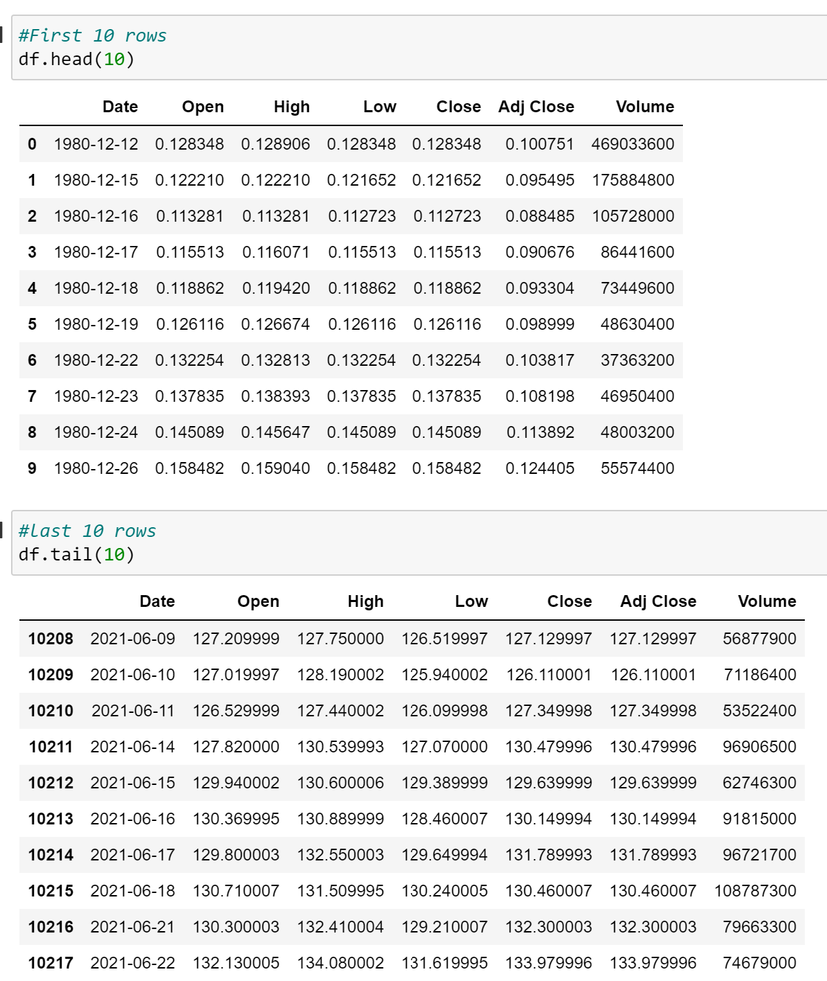
DATA COLLECTION
Dataset retrieved from https://www.kaggle.com/code/rerere/apple-stock-prediction
Dataset contains 10217 rows and 7 columns.

Slide 5
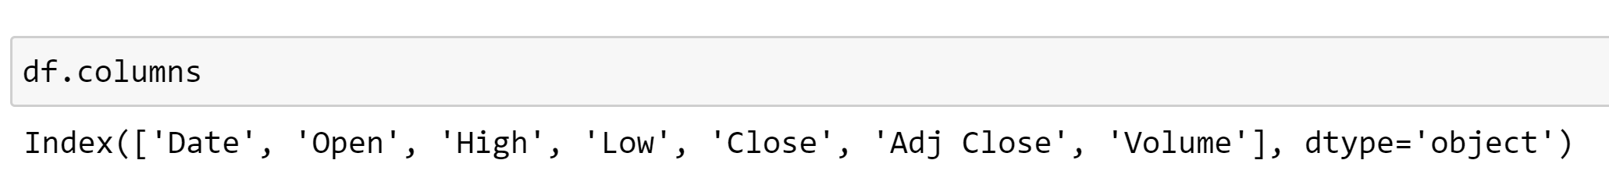
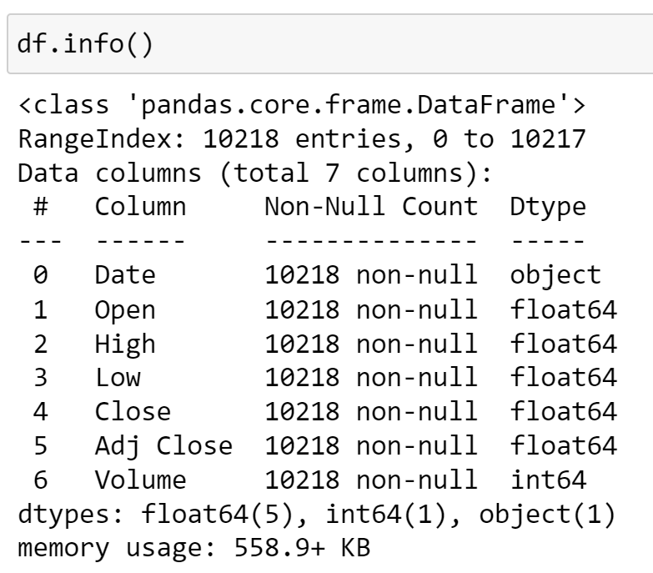
DATA UNDERSTANDING
7 columns are ‘Date’, ‘Open’, ‘High’, ‘Low’, ’Close’, ’Adj Close’, ’Volume’.
‘Open’, ‘High’, ‘Low’, ‘Close’, ‘Adj Close’ and ‘Volume’ columns contain numerical variables.
‘Date’ column contain date object in format YYYY-MM-DD.

Slide 6
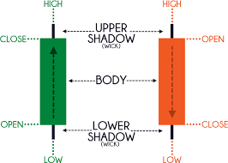
DATA UNDERSTANDING
Variables: “Date”, “Open”, “High”, “Low” and “Volume” in the dataset are independent variables. We will use these independent variables as input data to predict the close price of AAPL share as target variable.
History prices are from 12/12/1980 to 6/22/2021. That would be 10217 days in total.
We will choose close as a predicted variable and choose to ignore Adj Close price.
Because Adj Closing price amends a stock's closing price to reflect that stock's value after accounting for any corporate actions. The closing price is the raw price, which is just the cash value of the last transacted price before the market closes.

Slide 7
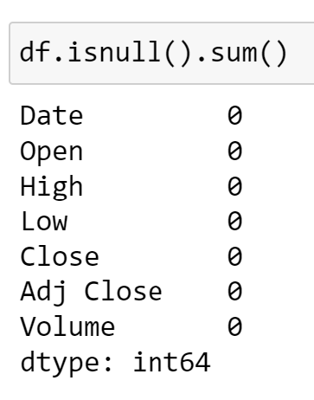
DATA PREPARATION
There is no Nan Values- no need to fill missing values with means in pandas

Slide 8
Data Preparation
Open | High | Low | Volume | Close
Train Dataset
Test Dataset

Slide 9
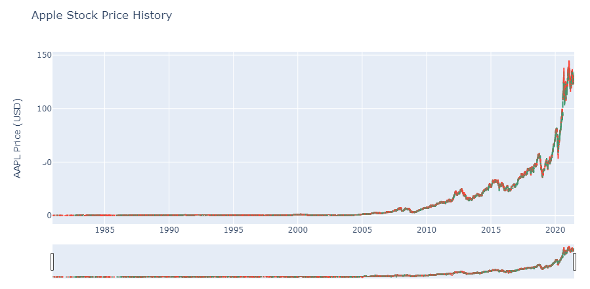
EXPLORATORY DATA ANALYSIS

Slide 10
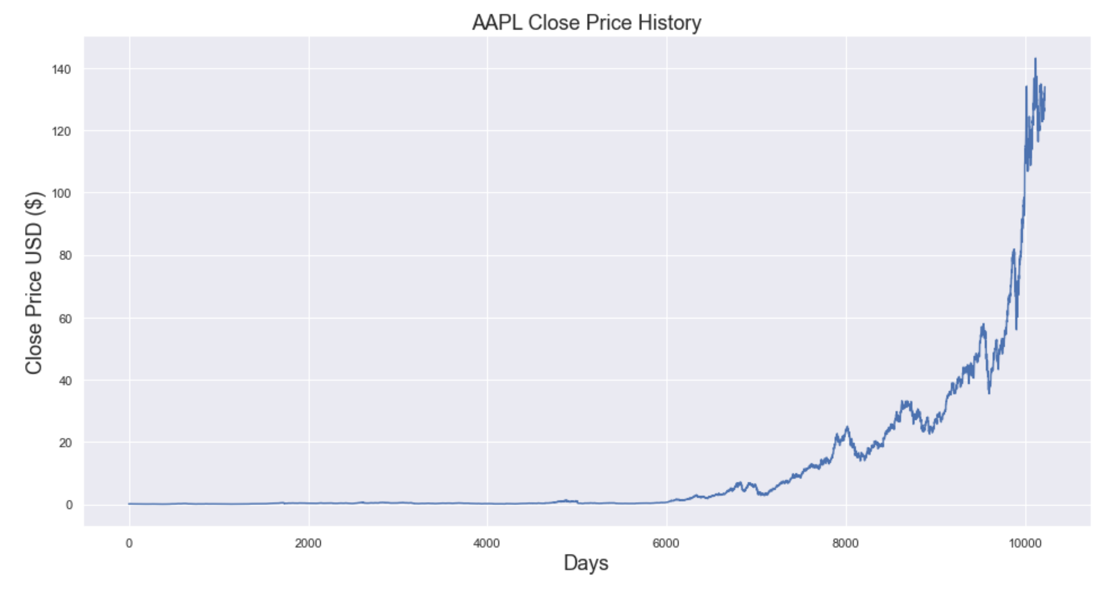
EXPLORATORY DATA ANALYSIS

Slide 11
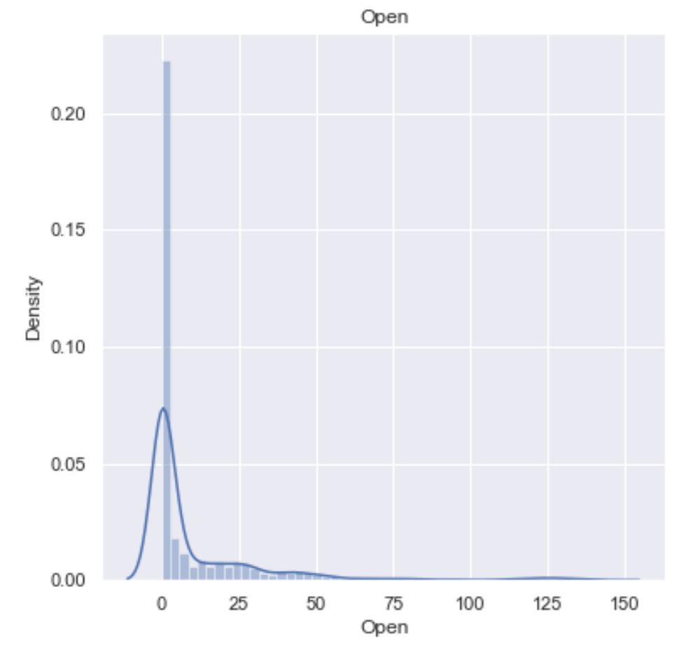
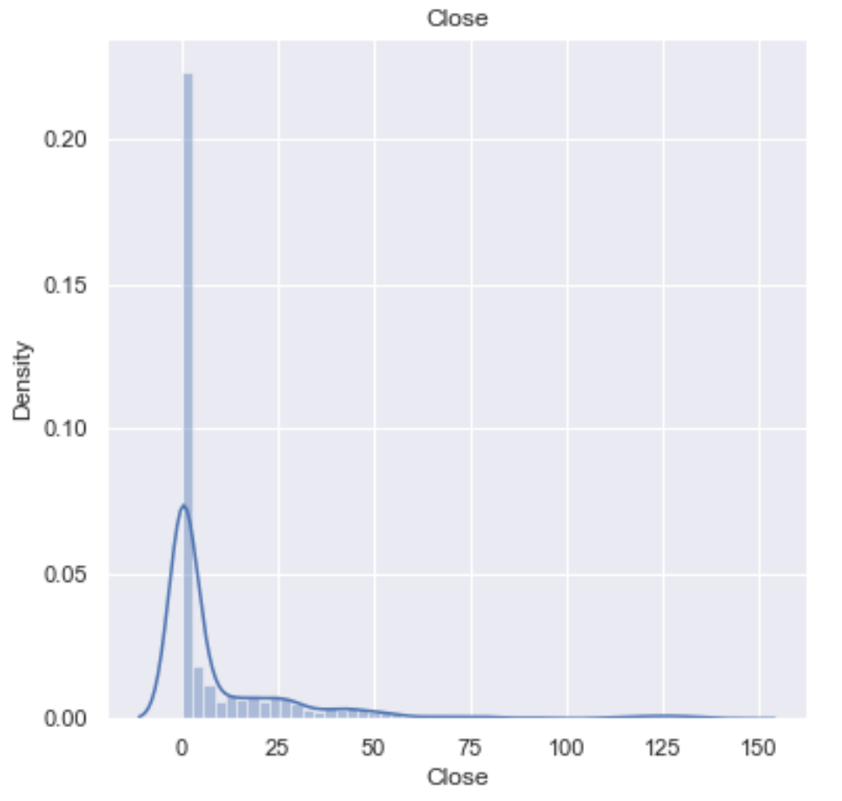
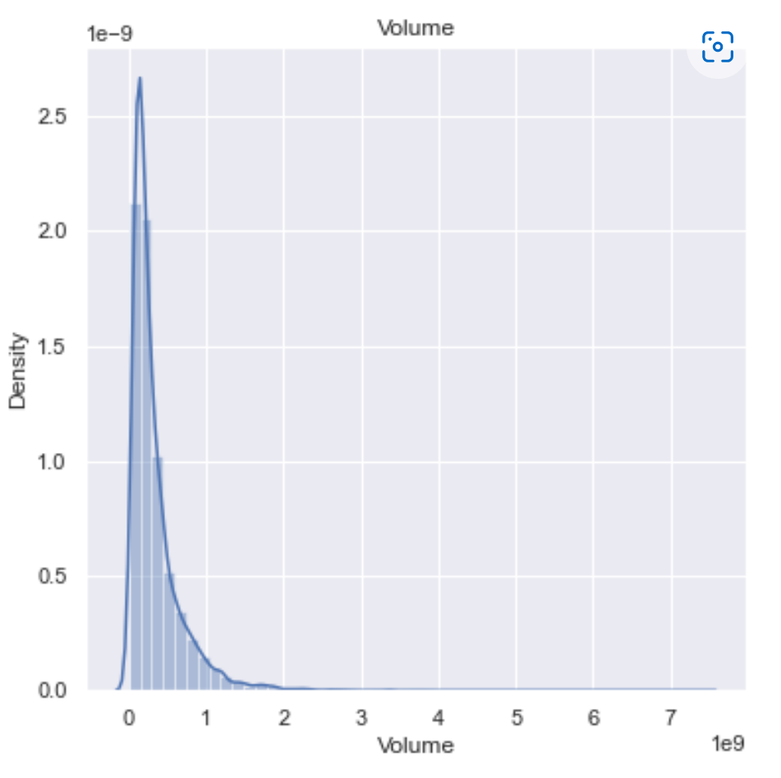
EXPLORATORY DATA ANALYSIS

Slide 12
Machine Learning
Multi Linear Regression Technique

Slide 13
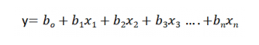
Linear Regression Technique
Equation of Multiple Linear Regression, where b0 is the intercept, b1,b2,b3,b4…,bn are coefficients or slopes of the independent variables x1,x2,x3,x4…,xn and y is the dependent variable.

Slide 14
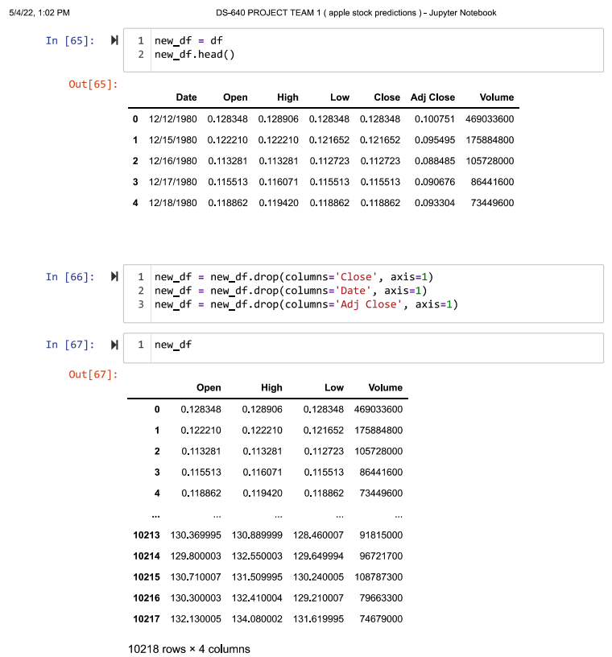
Dropping “Close”, “Date” and “Adj Close” column.
“Close” will be target variable, we will drop “Close”
We need to drop “Adj Close” as well because we choose to ignore “Adj Close”

Slide 15
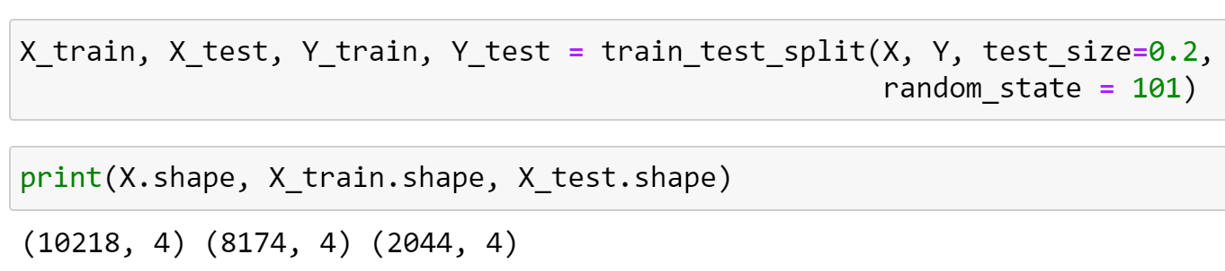
Determine X and Y values and allocate training dataset and testing dataset into 80:20
Open | High | Low | Volume | Close
Train Dataset
Test Dataset

Slide 16
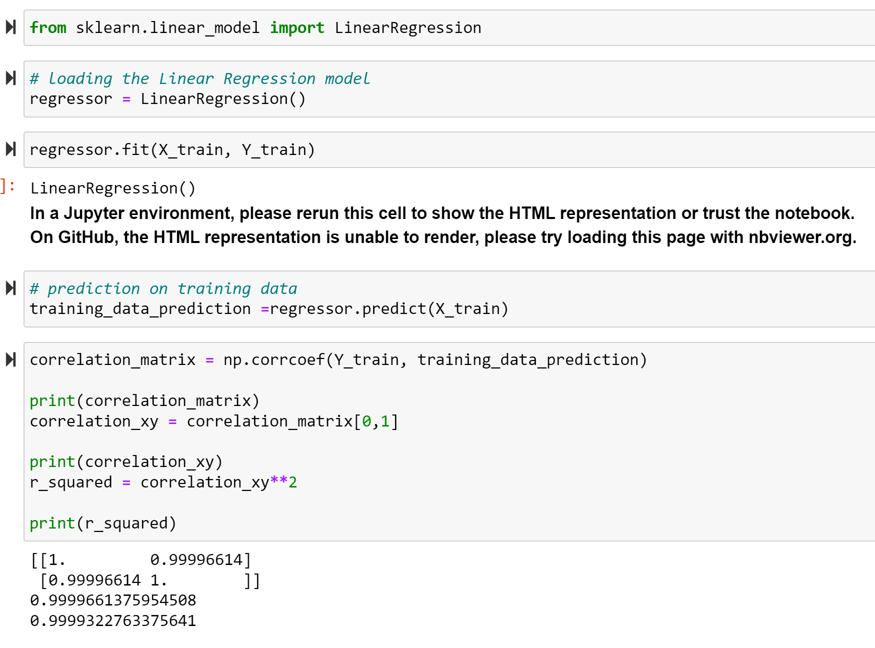
Correlation and R-Squared
The standards for a good R-Squared: ≥ 0.9
In finance:
R-Squared ≥ 0.7 : a high level of correlation
R-Square < 0.4 : a low correlation.

Slide 17
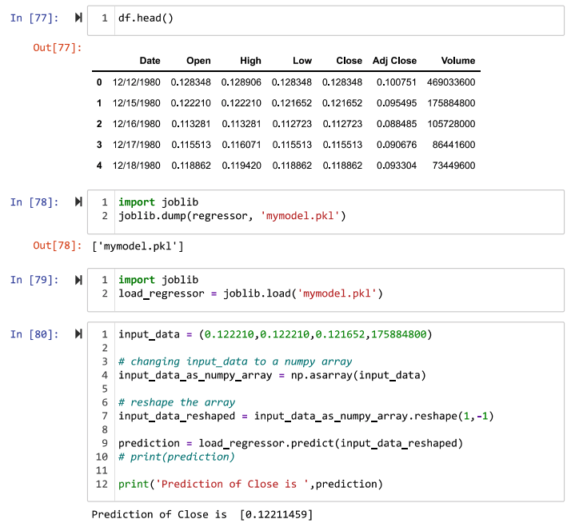
Testing the predicted value
Predicted Close = 0.12211459
Actual Close = 0.121652
Hence, the prediction is closed to actual value

Slide 18
Extension of the Project
We can use live data by importing financial data and trading data from Yahoo Finance directly to Python
import yfinance as yf
import datetime
start = datetime.datetime(2020,1,31)
end = datetime.datetime(2022,5,17)
AAPL = yf.Ticker("AAPL")
print(AAPL.history(start=start, end=end))
Import data from TradingView to Python by web scraping.
We can use the ML to add more indicators for traders such Moving Average, Fibonacci, RSI and so on.
Trading bot may be created by ML for this project.

Slide 19
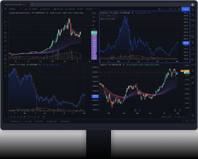
Extension of the Project
Depend on the stakeholders that this project is for, we can import live data to predict the close price, financial ratios, ER Earning Ratio, ROE,..
Day by day for long term traders, swing traders, short term traders that use 1-day candlestick.
Hour by hour, or minute by minute, or 3min by 3min, and so on for day traders, scalping
Machine learning empowers traders to accelerate and automate one of the most complex, time-consuming, and challenging aspects of algorithmic trading, providing a competitive advantage beyond rules-based trading.

Slide 20
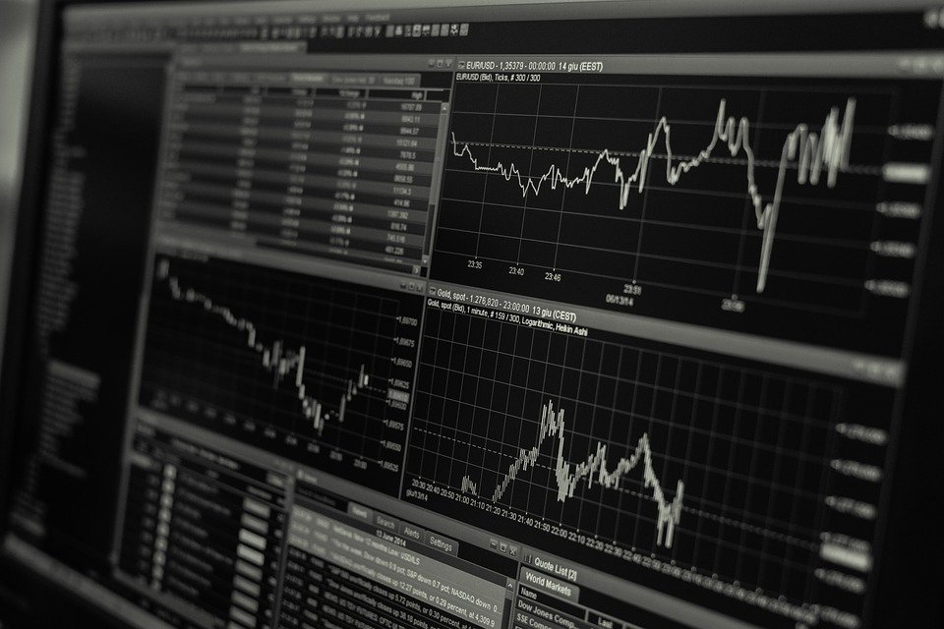
THANK YOU!

